Slide 1

Kernel Re-Implementation
By:
Vikram Tiwari
Shivam Gupta
Tanishka Chaturvedi

Slide 2
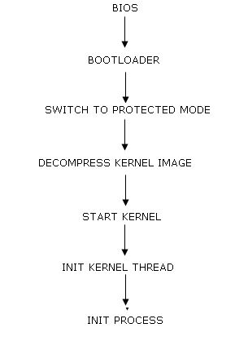
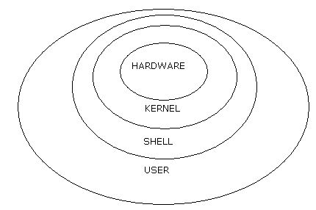
What is Kernel?

Slide 3
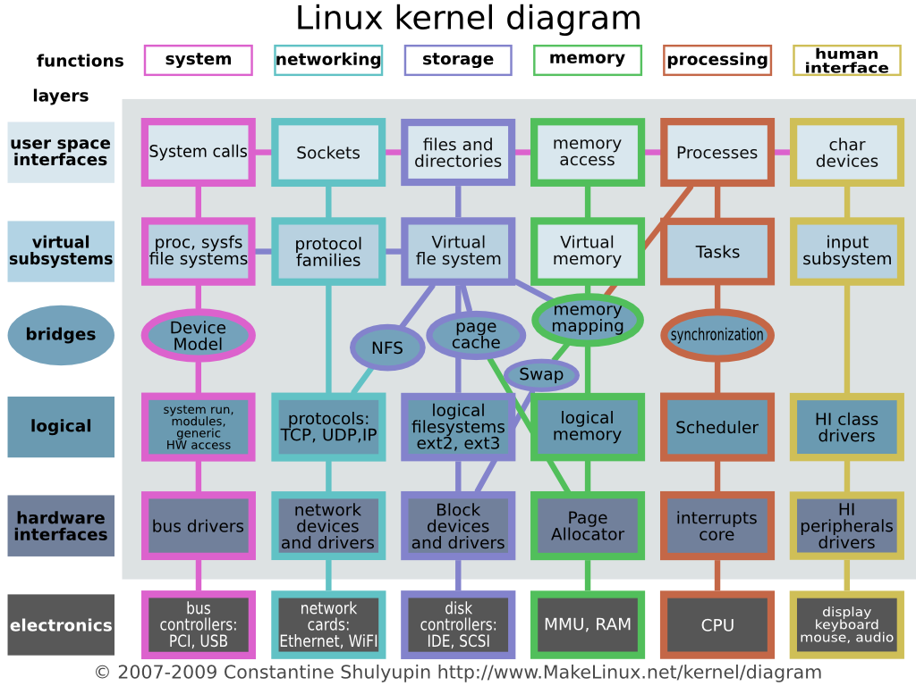
A more detailed description

Slide 4
How the kernel is developed?
Hardware Interfaces
Logical Interfaces
Bridges
Virtual File System
User Mode

Slide 5
Hardware Interfaces
A Bare System
Contains POST program
No Operating System
No OS Found Error
Requires Boot loader
Boot Code
Monitor Interfaces

Slide 6
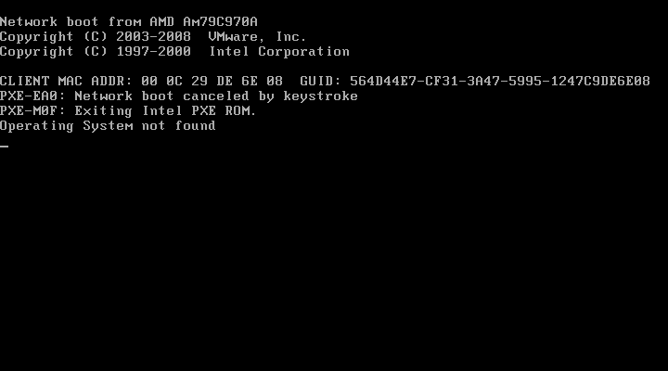
Hardware Interfaces

Slide 7
Logical Interfaces
System Abstraction
Memory Level Abstraction
Interrupt Interfaces
Global Descriptor Table
Interrupt Descriptor Table

Slide 8
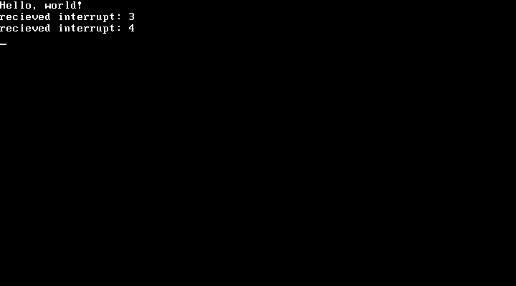
Logical Interfaces

Slide 9
Bridges
Request Queues
Programmable Interval Timer
Virtual Memory
Page faults

Slide 10
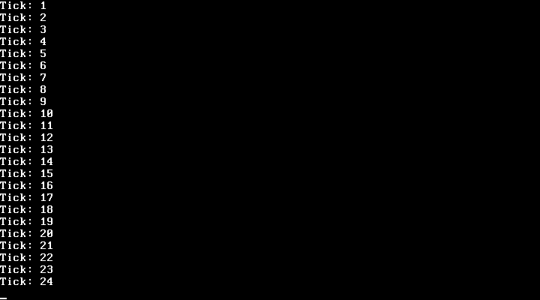
Bridges

Slide 11
Virtual File System
File system Level Abstraction
Uniformity Location
Common Access
Integration

Slide 12
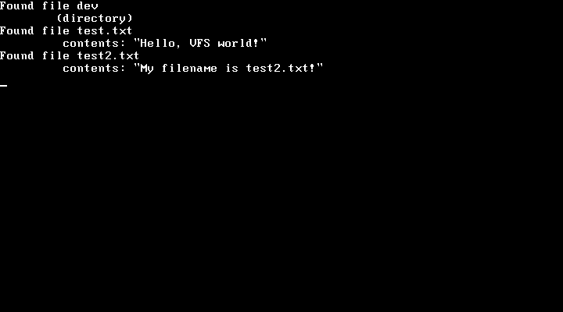
Virtual File System

Slide 13
User Mode
Multitasking
Stack Creation
Cloning
System Calls
Macros

Slide 14
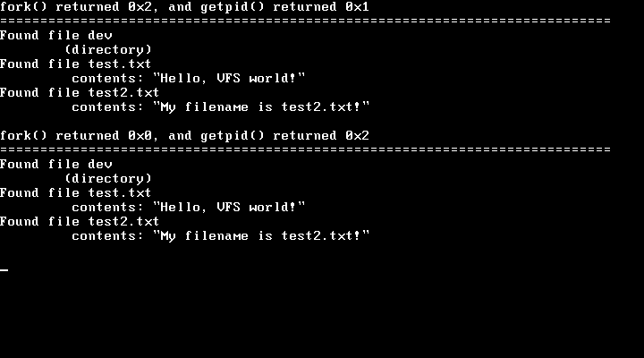
User Mode

Slide 15
Usability
Bridge between applications and the actual data processing done at the hardware level.
Managing the system's resources (the communication between hardware and software components).
Provide the lowest-level abstraction layer for the resources (especially processors and I/O devices)

Slide 16
Live Demo and Queries

Slide 17
Further Enhancements
Boot Loader Development
Networking Implementation
SWAP Memory Implementation
GUI and Human Interface
Implementing Cryptology

Slide 18
Thanks!

